Slide 1

MUSIC PLAYER
Group members with StudentId
SOHAM MORE [21104042]
RONIT NAIK [21104083]
ROHIT NIGADE [21104101]
Project Guide
Prof. SONAL JAIN

Slide 2
Contents
Introduction
Objectives
Scope
Features / Functionality
Project Outcomes
Technology Stack
Block Diagram/ Flow

Slide 3
1. Introduction
Problem Statement :
Design and implementation of the music player based on Java.
Bloated software and user interfaces.
Due to the fierce competition between music player applications, many developers tried to add many features, advertise and content to their respective music player in order to retain their users and attract new users. This trend has made it harder for users to get content from their music player, which also means it's harder to filter the content that they want.
Solution Proposed :
    Make it with a simple feature and run smoothly
    By using this mp3 music player will make users fell comfortable and relaxed because it will pay more attention to the features commonly used by users, excluding some rarely used features that occupy a large of system processors, making the music player lightweight, simple, but also has powerful basic features.

Slide 4
2. Objectives
To enhanced audience experience.
To reduce their stress and since we all have a variety of emotions, music comes in all type of styles.
To make it with a simple feature and run smoothly.
To support mp3 media files and has the ability to play them with ease.

Slide 5
3. Scope
They are portable digital music players that play music as audio files.
The music player is a software project supporting MP3 files.
Makes your mood pleasant.

Slide 6
4. Feature /Functionality
Plays selected mp3 music files
Better UI design using j-frames.
(J-Frame works like the main window where components like labels, buttons, textfields are added to create a GUI.)
Pausing the music
Resuming the music
Stopping the music
Going to next music in playlist
Going to previous music in playlist
Allows the user to select only .mp3 file format songs from their local storage and play them.
Minor Feature- Can play .gif files as well
Basic Minimize, Close button

Slide 7
5. Outcome of Project
Below are the steps to describe how a new user will execute the proposed interface.
1.The user first execute the application, he or she needs to give the proposed application the permissions it needs to read local songs and load them into the song playlist.
2. Users can play a song by clicking on one of the songs on the playlist.
3. In the song playback interface, the user is allowed to drag the bar, as well as perform various function through the icon button.
4. The user can create the playlist according to there choice and can shuffle.(can be added)

Slide 8
6. Technology Stack
GUI made using J-frames in ECLIPSE IDE.​
The use of jframes are more reliable as they help in making a rich GUI even for new users.
IDEs like Netbeans help in doing so as they are specially made for Swing projects.
These makes project frontend more easy to implement and in faster manner than Traditional methods.
The javax.swing.JFrame class is a type of container which inherits the java.awt.Frame class. JFrame works like the main window where components like labels, buttons, textfields are added to create a GUI.
NetBeans used to make the classes of J-forms.
Classes made in NetBeans imported in the Eclipse IDE for debugging and final build.

Slide 9
7. Block Diagram/ Flow Chart
Launcher
Animation
PLAYER
Exit
Move Mouse Listener
Marquee Label

Slide 10
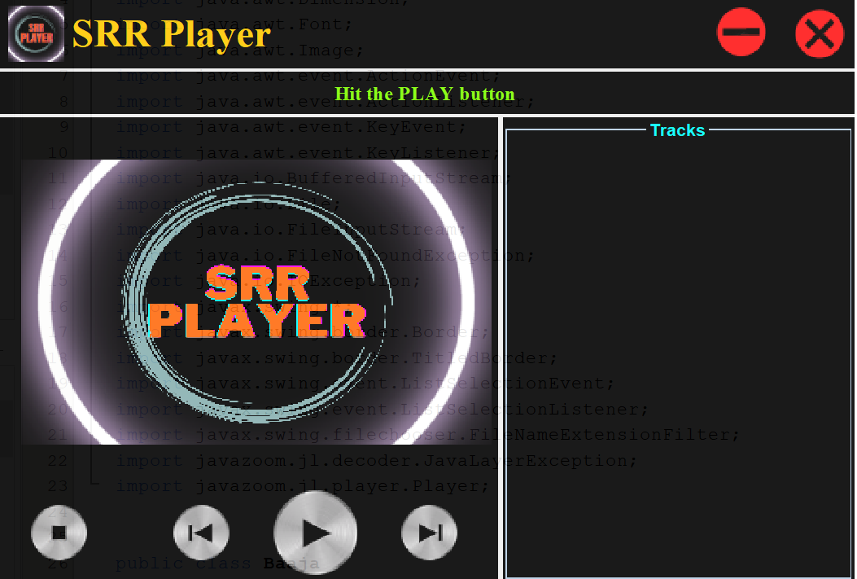
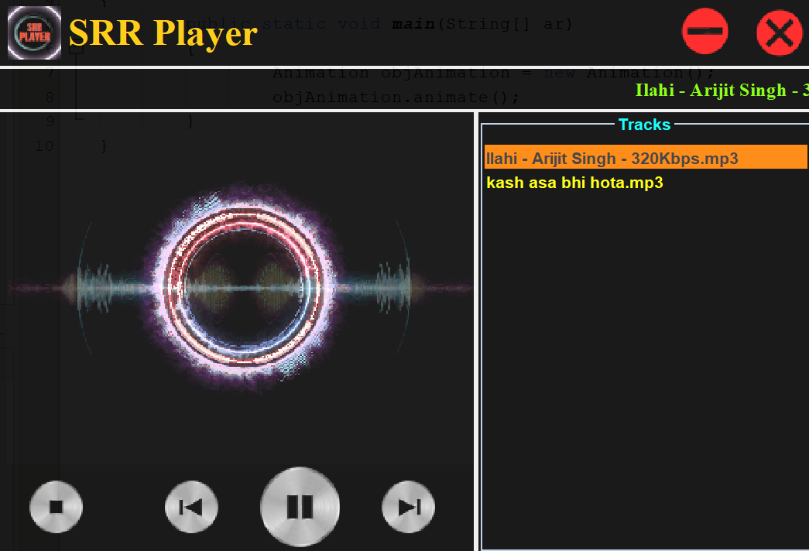
TEMPLATE

Slide 11
Thank You...!!

